Slide 1

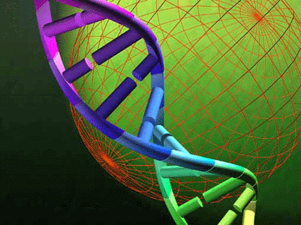
Genetic Algorithm and Heuristic Search For Solving Timetable Problem Case Study : Universitas Pelita Harapan
Samuel Lukas
Arnold Aribowo
Milyandreana Muchri

Slide 2
Agenda
Introduction
Proposed Method
Basic Concept
Scheduling Process
Implementation
Experiment Result
Conclusion

Slide 3
Introduction
Scheduling problem is a model of complex problem.
Many constrains should be considered in solving time table problem.
Showing the powerfulness of genetics algorithms combined with heuristics search.
Next

Slide 4
Proposed Method
Next

Slide 5
Basic Concept
Permutation Encoding
Truncation Selection
Cycle Crossover
Reciprocal Exchange Mutation
Fitness
Heuristic Search
Next

Slide 6
Permutation Encoding
Each Chromosome is composed by a sequence of integers
Each integer represents a course being scheduled in one semester
There is no same gene in one chromosome
Each chromosome represents one possible schedule in the semester
Next

Slide 7
Truncation Selection
Population
5 2 3 1 4
3 1 5 4 2
2 4 1 3 5
1 4 3 5 2
1 4 3 5 2
2 5 3 4 1
2 5 3 4 1
Population with four chromosomes in a generation
25 % truncation selection is applied
Next

Slide 8
Cycle Crossover
Parent 1 :
Parent 2 :
Child 1 :
Child 2 :
1
5
3
4
2
3
4
2
5
1
1
4
3
5
2
3
5
2
4
1
Next

Slide 9
Reciprocal Exchange Mutation
Old chromosome New Chromosome
3
2
5
4
1
3
4
5
2
1
Next

Slide 10

Fitness
Determining the fitness of the chromosome.
dimana
Unit credits of the j^{th} course of the i^{th} chromosome able to be scheduled.
Unit credits of the k^{th} course of the i^{th} chromosome
Next

Slide 11
Heuristic search
Code | Type | Class | Unit | Lecturer
 | t1 | =A | 2
 | t1 , t2 | =Z | 2
 | t2 | =B | 2
-1
-1
0
0
1
-1
1
-1
Unit = 2
-1
1
-1
1
-1
0
0
-1
Counter = 0
Counter = 1
Counter = 2
0
1
0
1
0
-1
-1
0
-1
-1
1
0
1
-1
-1
-1
0
0
-1
0
Fitness = 0
Fitness = 0.667
Fitness = 0.333
Fitness = 1
-1
-1
0
0
1
1
-1
-1
-1
1
-1
-1
0
-1
0
1
0
0
1
0
1
-1
-1
0
-1
-1
-1
-1
1
0
0
1
-1
-1
0
0
Next

Slide 12
Scheduling Process
Scheduling is divided by four groups of semester
Group of semester | Semester
1 | 1 and 2
2 | 3 and 4
3 | 5 and 6
4 | 7 and 8
Next

Slide 13
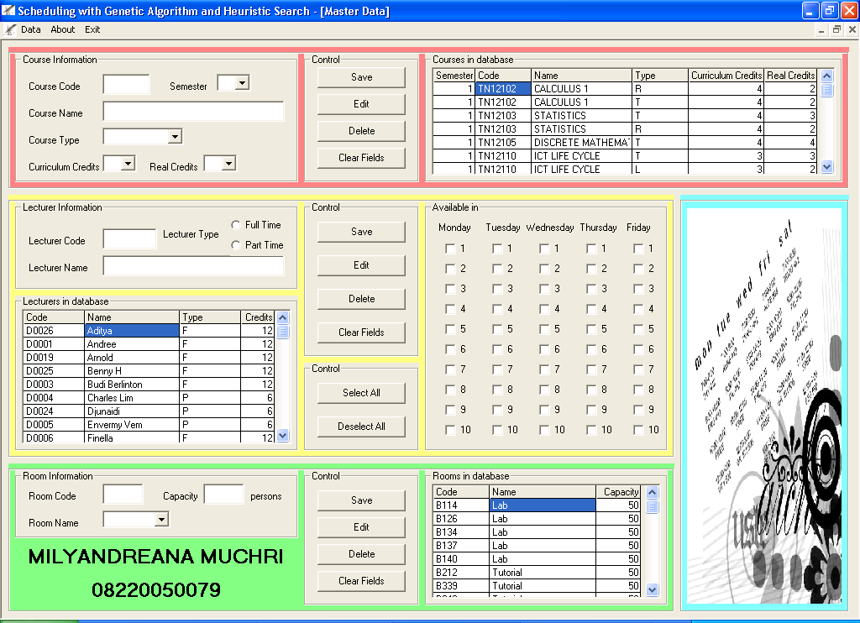
Implementation
Next

Slide 14
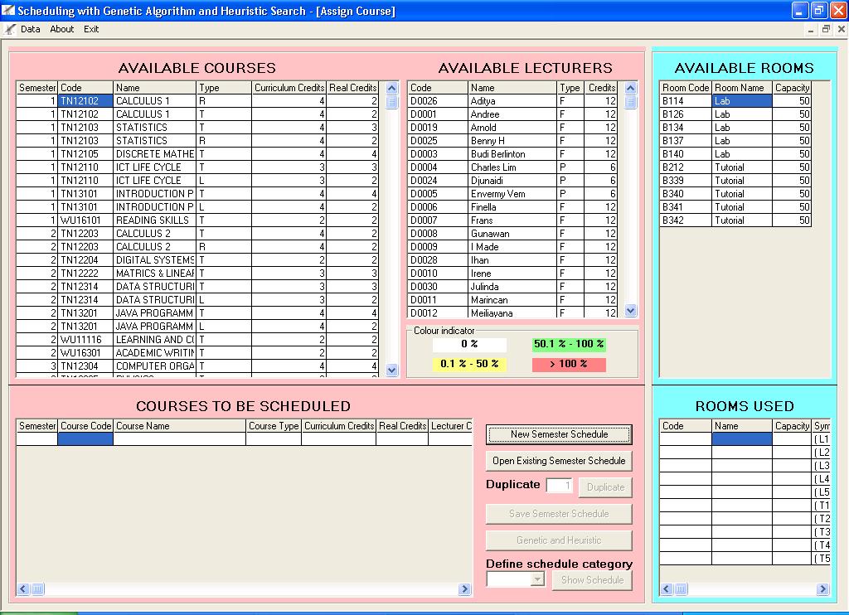
Subject Scheduled Form
Next

Slide 15
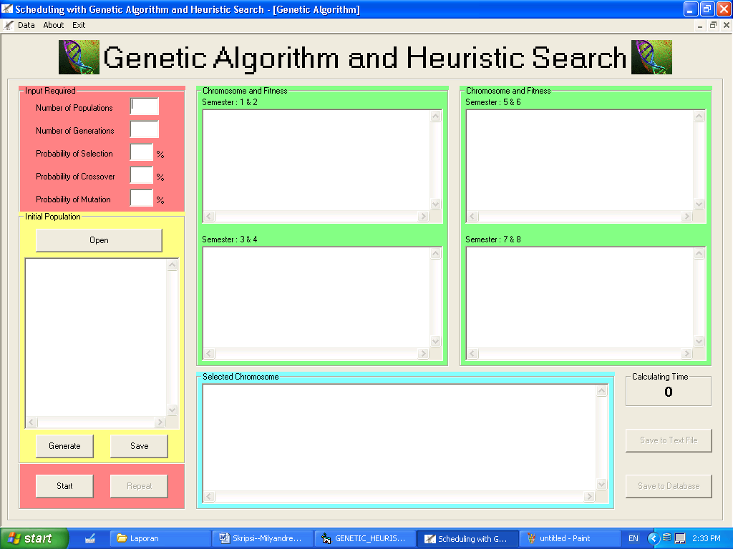
Scheduling Form
Next

Slide 16
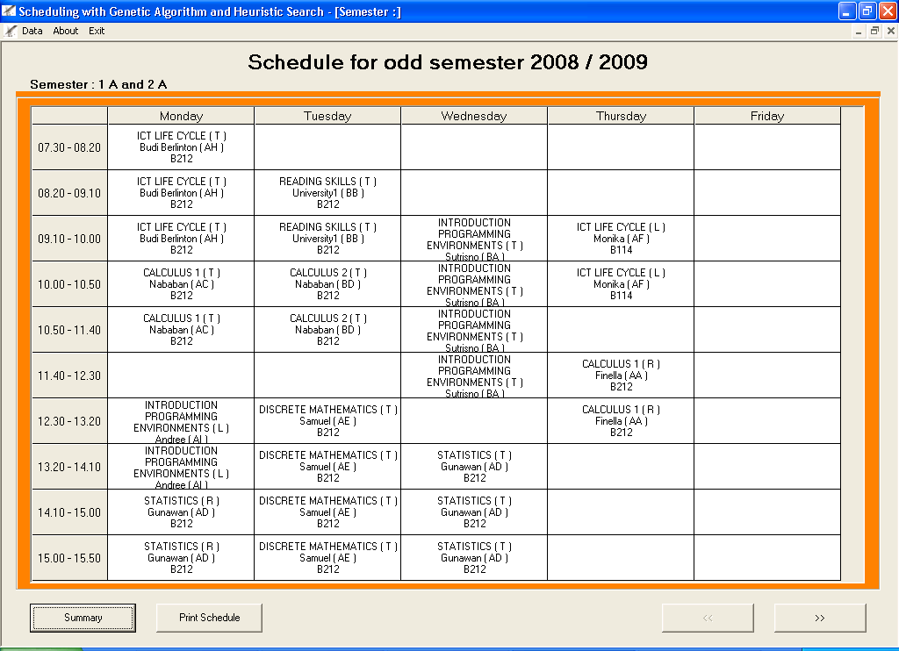
Scheduled Result Form
Next

Slide 17
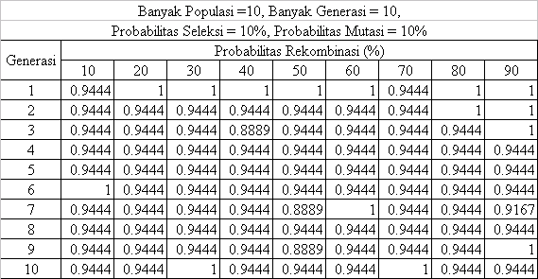
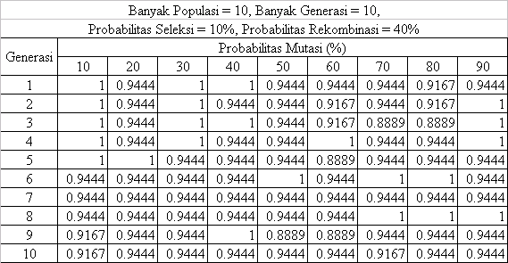
Experiment Result
Next

Slide 18
Conclusion
Genetic algorithm and heuristic search can solve timetable problem.
System can find the schedule with less number of chromosome in population accurately.
The fitness depends on two major factor. They are lecturer time availability and the sequence of gene in chromosome.
Next

Slide 19

Thank You

